Slide 1
STA,AP, IBSS,BSS,DS, ESS Types of Services in Wi-Fi
VARUN KUMAR SUNDARA

Slide 2
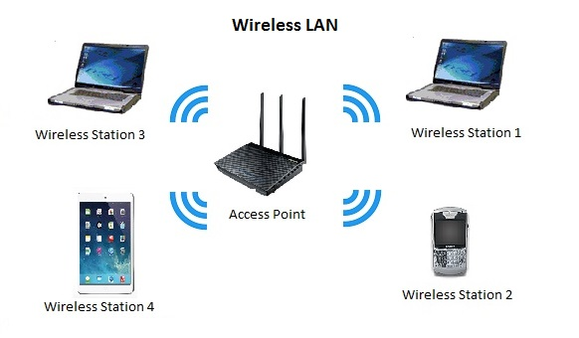
STATION:
A station is a device, like a laptop or smartphone, that connects to a wireless network and communicates with other devices on that network.
It can act as a client, requesting information or services from other devices, or as an access point, providing wireless access to other devices.
The role of a station is important for enabling communication between devices and providing access to network resources.

Slide 3
ACCESS POINT:
Any entity that has station functionality and provides access to the distribution services, via the wireless medium for associated STAs.
a wireless access point (WAP), or more generally just access point (AP), is a networking hardware device that allows other Wi-Fi devices to connect to a wired network.
Access point is a half duplex.
Has the intelligence like the switch.
Operates on Data link layer.

Slide 4
Types of Access Points:
Depending on the functionalities, Wireless Access Points can be categorized into three types. They are:
1. Standalone access point.
2. Multifunction Access Point.
3. Controlled Access Point.

Slide 5
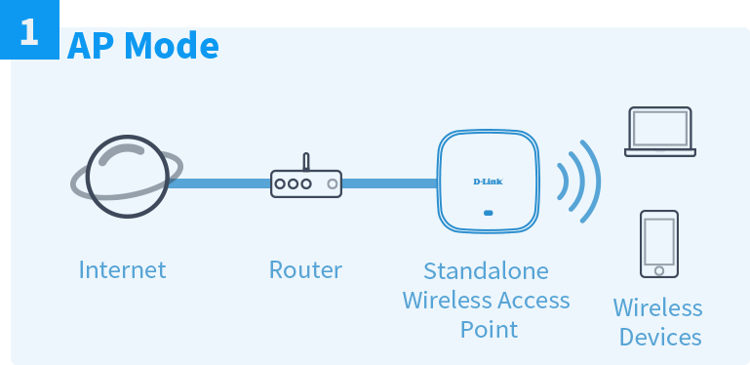
STANDALONE ACCESS POINT :
It is a network access point that offers similar functionality in a wireless network that a hub provides to a wired network.
It accepts and relays frames from a connected device and forwards it to the destination device based on its physical address.
Typically, a standalone access point is used in commercial establishments like offices, public places, etc.

Slide 6
Multifunction Access Point :
A multifunction access point is a device that combines the functionality of multiple networking devices into a single unit.
It can provide wireless access to a network, act as a router to connect multiple networks together, and offer additional features such as firewall protection and VPN support.
A multifunction access point can be used in a variety of settings, such as homes, small businesses, and large enterprises.
It can be particularly useful in environments where space is limited or where multiple networking functions are needed, as it can eliminate the need for multiple devices and simplify network management.

Slide 7
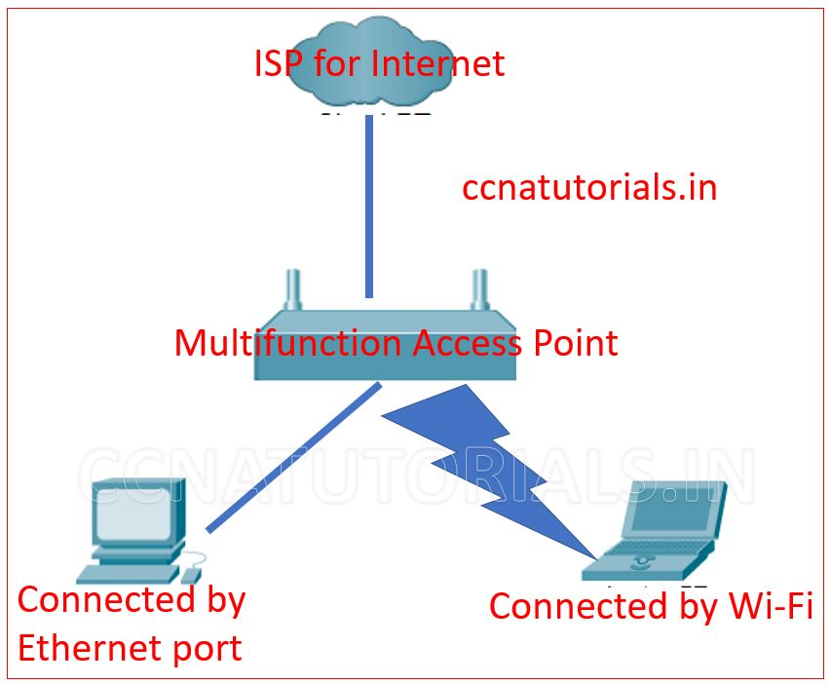
MULTIFUNCTION ACCESS POINT :

Slide 8
Controlled Access Point :
A controlled access point (CAP) is a network device that allows authorized users to connect to a network or the internet via a wireless or wired connection
CAPs are commonly used in enterprise and public Wi-Fi networks, as well as in various security systems.
A CAP can be either a standalone device or integrated into other network equipment, such as a router or a switch.
It typically has several features that allow administrators to control who can access the network, how they can access it, and what they can do once connected. Some of these features include:
Authentication: Users must provide valid credentials, such as a username and password, to gain access to the network.
Encryption: The CAP can use encryption protocols, such as WPA2, to secure the connection between the user and the network.
Access control: Administrators can set up rules to limit access to certain resources or to specific users or groups.
Guest access: The CAP can provide a separate network for guests or visitors, with limited access to resources and services.

Slide 9
BASIC SERVICE SET(BSS):
BSS stands for Basic Service Set, which is a fundamental building block of a wireless local area network (WLAN).
A BSS is a group of wireless devices that are communicating with each other over a shared wireless medium using the same wireless network name (SSID).
A BSS typically consists of a single AP and one or more wireless devices, such as laptops, smartphones, or tablets.
The AP acts as a central point that manages communication between the devices in the BSS and also provides a connection to the wired network.
A WLAN can have multiple BSSs, each with a unique SSID, which enables multiple groups of devices to communicate with each other in parallel without interfering with each other.
In addition, devices can roam between BSSs, moving from one coverage area to another, while maintaining a continuous connection to the network.

Slide 10
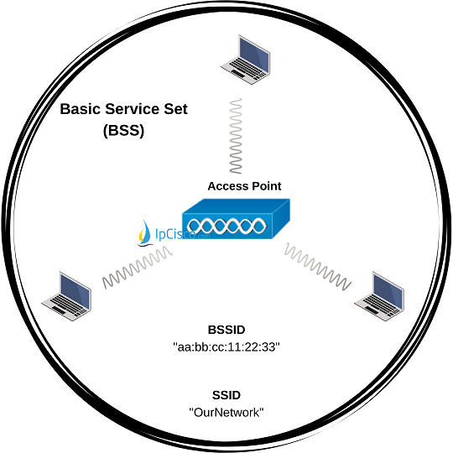
BASIC SERVICE SET(BSS) :

Slide 11
INDEPENDENT BASIC SERVICE SET (IBSS) :
An Independent Basic Service Set (IBSS) is a type of wireless network in which devices communicate directly with each other without the need for a central access point. IBSS is also sometimes referred to as an ad-hoc network.
IBSS devices form a network on an ad-hoc basis, without any infrastructure or pre-existing network.
Each device in the network functions as a peer, with no central point of control or coordination.
IBSS is useful in situations where a WLAN infrastructure is not available or not practical.
IBSS has some limitations, such as limited coverage area and lower security compared to a WLAN with an access point.

Slide 12
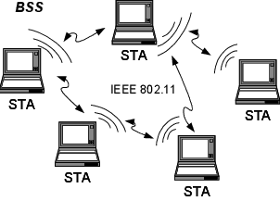
INDEPENDENT BASIC SERVICE SET(IBSS) :

Slide 13
DISTURBUTION SYSTEM(DS):
A wireless distribution system (WDS) is a method of interconnecting access points (AP) in a wireless local area network (WLAN) without requiring that they connect through a wired backbone.
The IEEE 802.11 standard defines a distribution system as the infrastructure used to connect access points.
To establish a distributed WLAN, two or more access points are configured with the same service set identifier (SSID).
Access points configured with the same SSID make up a single logical network within a single Layer 2 broadcast domain, which means that they must all be able to communicate. The distribution system is the method used to connect them so they can do that.
In a wired distribution system, APs typically connect through an Ethernet switch.

Slide 14
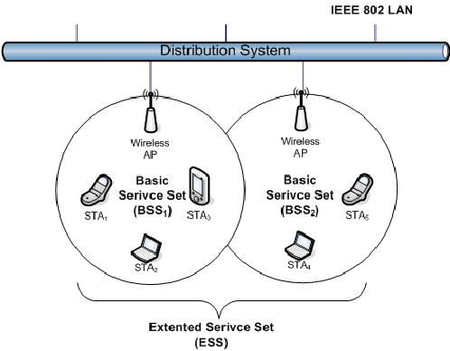
DISTURBUTION SYSTEM(DS) :

Slide 15
EXTENDED SERVICE SET (ESS) :
An extended service set (ESS) is one or more interconnected basic service sets (BSSs) and their associated LANs.
Each BSS consists of a single access point (AP) together with all wireless client devices (stations, also called STAs) creating a local or enterprise 802.11 wireless LAN (WLAN).
ESS supports mobility i.e. client or user can move from one place or location to another and can still be connected to LAN without any interruption.
It provides long range wireless communication.
ESS supports mobility i.e. client or user can move from one place or location to another and can still be connected to LAN without any interruption.
ESS supports mobility
i.e. client or user can move from one place or location to another and can still be connected to LAN without any interruption.

Slide 16
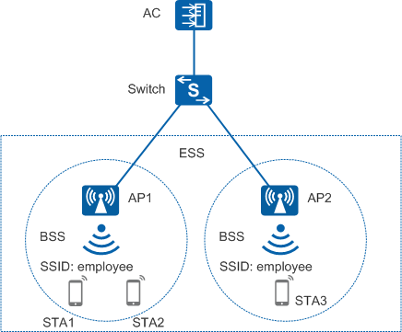
Extended SERVICE SET(eSS) :

Slide 17
TYPES OF SERVICES IN WIFI :
The IEEE specifies two major categories of 802.11 services called the station service and the distribution system service, which both operate at the MAC sublayer.
STATION SERVICE :
The station service (SS) is used by all 802.11 client stations including APs.
Access points also use station services because they also have STA functionality.
Station services include the following:
Authentication
DE authentication
Encryption
MSDU delivery
Dynamic frequency selection (DFS)
Transmit power control (TPC)
Higher-layer timer synchronization (QoS facility only)
QoS traffic scheduling (QoS facility only)

Slide 18
DISTURBUTION SYSTEM SERVICE(DSS):
The distribution system service (DSS) is comprised of MAC sublayer services that are provided by the distribution system
The distribution system service provides the following:
Association
Reassociation
Disassociation
Distribution
Integration
QoS traffic scheduling (QoS facility only)

Slide 19
Thank you

